Slide 1








Archaeology of Intelligent Machines
BIAS IN ML
By Adrian Sefcic and Andrei Hârnagea

Slide 2



Contents
1
INTRODUCTION
4
LIMITATIONS
2
EXAMPLES OF BIAS
5
CONCLUSIONS
3
APPROACH

Slide 3


Introduction
Definition of Bias in AI
Importance of Addressing Bias
Project Objective: Sentiment Analysis in Romanian Texts

Slide 4
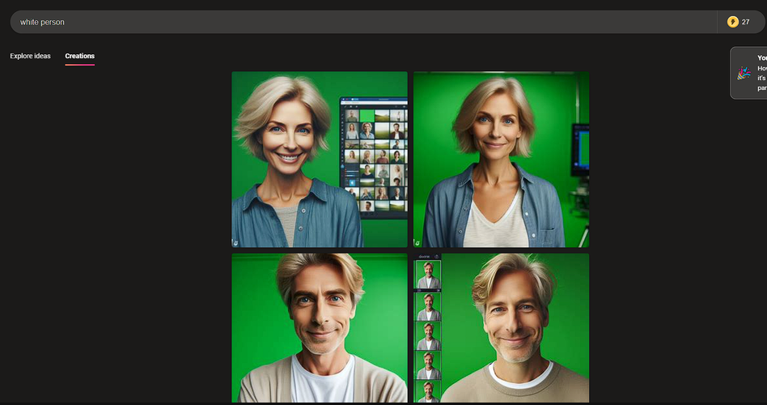
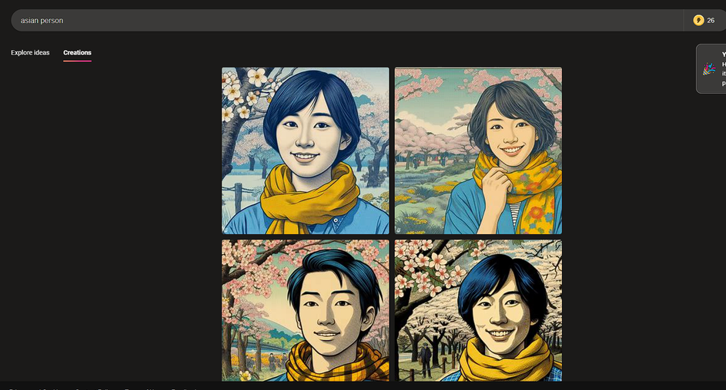
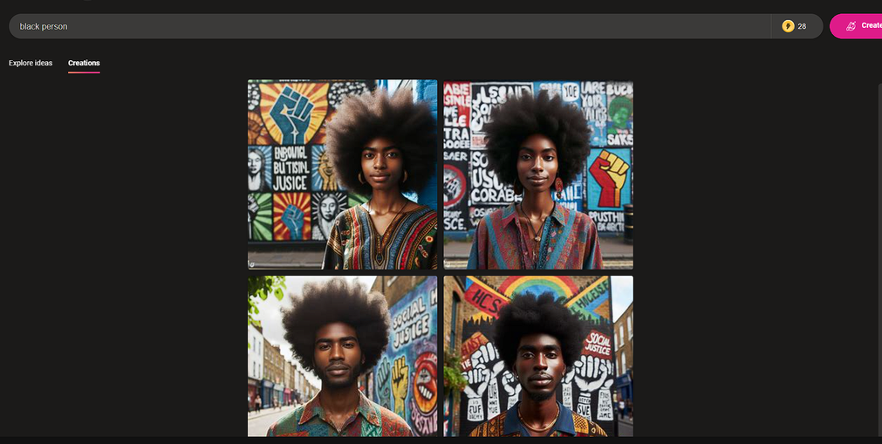
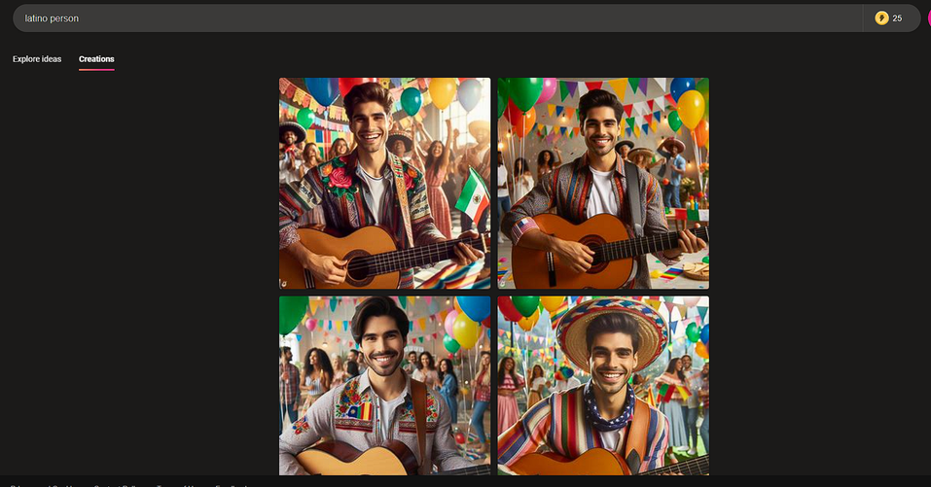
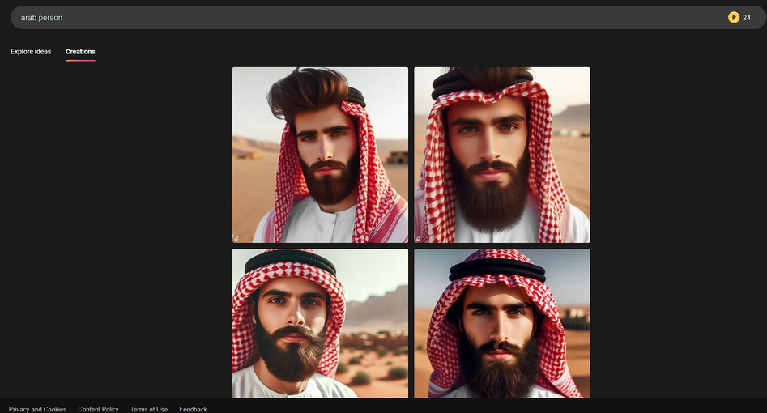
Examples of Bias
“white person”
“asian person”
“black person”
“latino person”
“arab person”
all genertated with Bing AI

Slide 5


Approach
3. Creating Random word samples
Loading Word Embiddingds
2. Loading Lexicons
6. Converting Words and Text to Sentiments
4. Processing Text with Spacy
5. Training a Sentiment Classifier

Slide 6
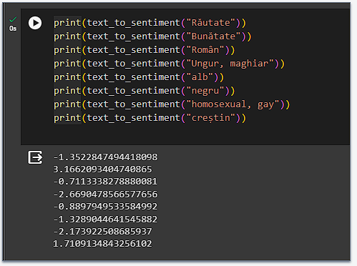
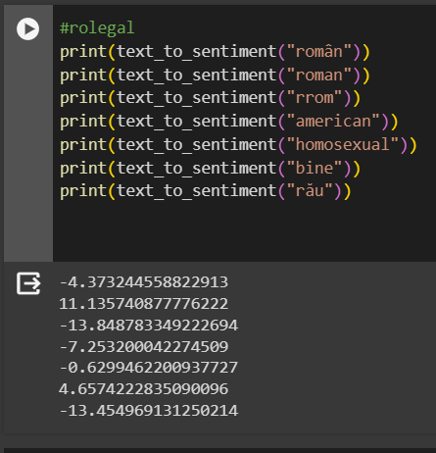
Results
Results with MUSE
Results with ro-legal

Slide 7



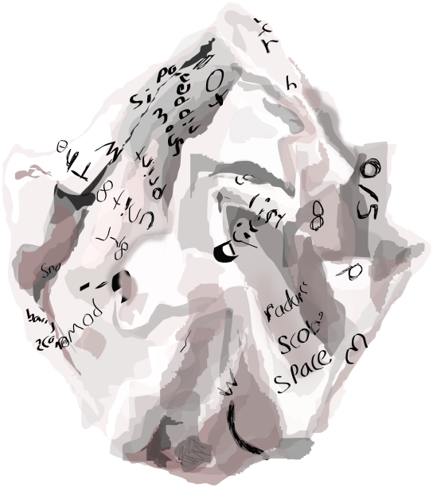
Limitations
Not enough resources
Limited computing power

Slide 8

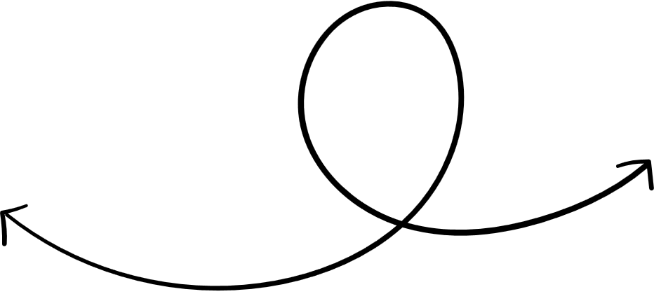
Conclusion
The problem is within the database, since humans are usually biased, so the data tends to also be biased.

Slide 9

Thanks!

